Slide 1
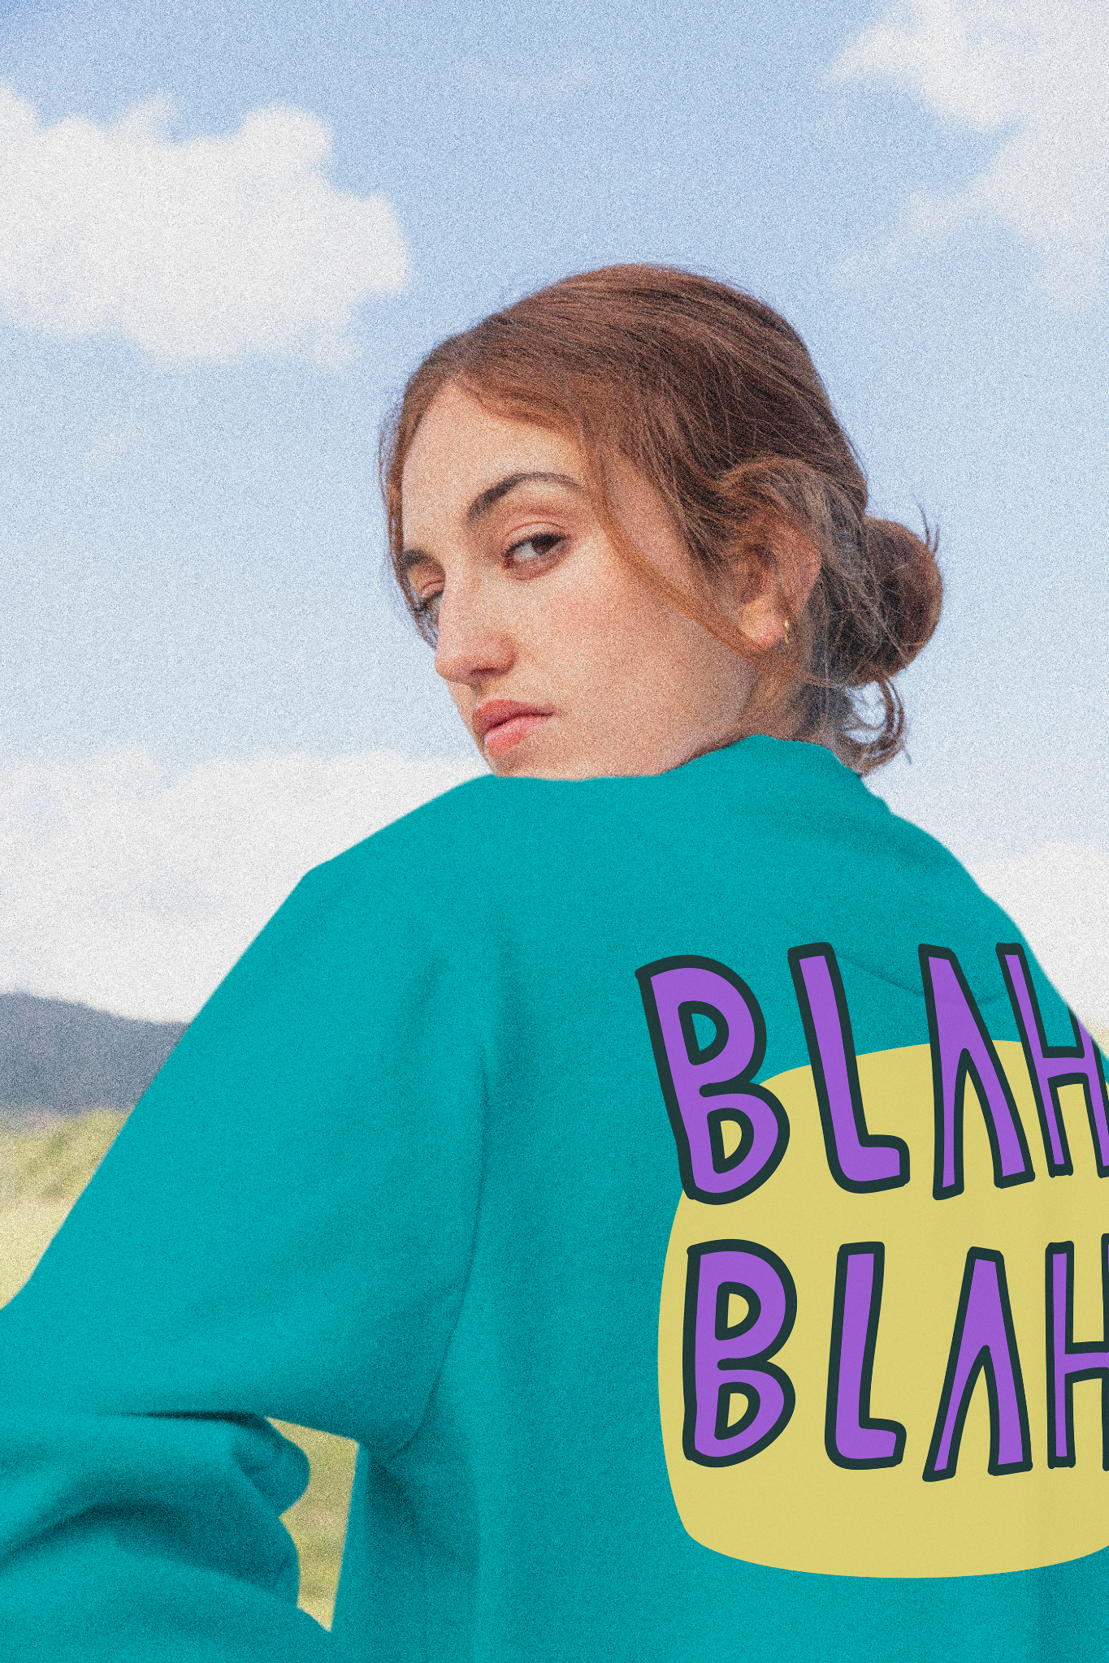
Thrift FASHION

Slide 2
table of contents
01
02
Introduction
Group member introduction
03
04
Entity realationship diagram / database diagram
Project’s function

Slide 3
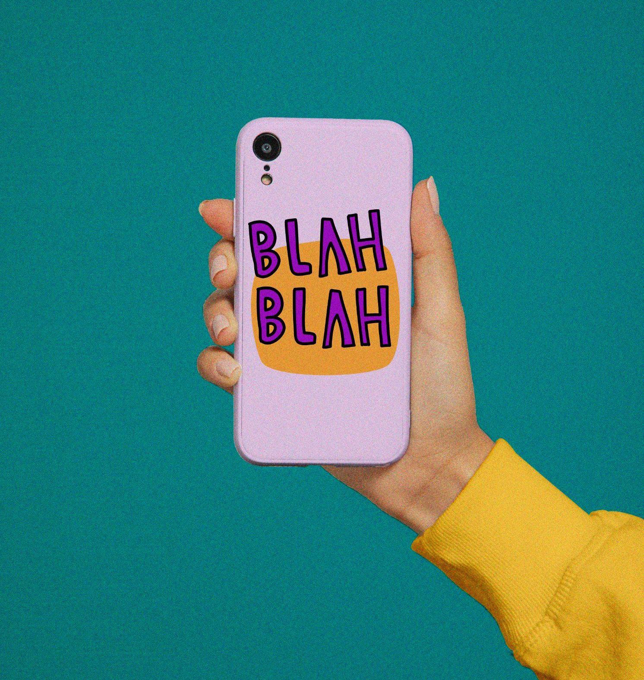
01 INTRODUCTION
These days, recycling, sustainability, and reuse are not just buzzwords, but actionable behaviors to support a better planet. Instead of discarding clothes that are still in good condition, but no longer required by the original buyers, these clothes can be sold as thrift fashion or pre-used clothing.
In simple terms, shopping for thrift fashion is second hand purchases for fashionable clothing

Slide 4
02 Group member introduction

Slide 5
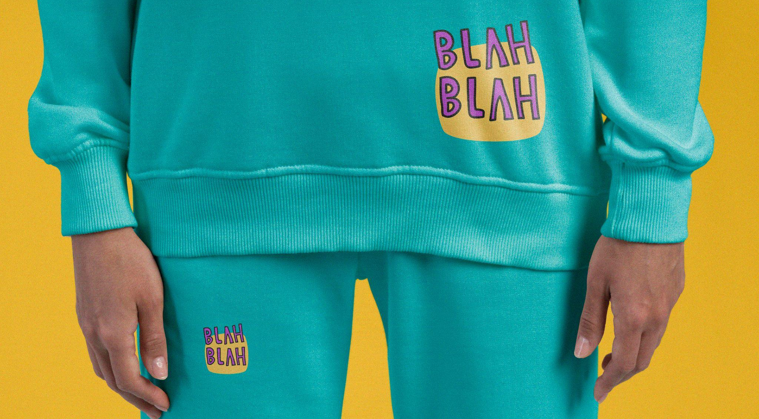
03
Entity realationship diagram / database diagram

Slide 6
Entity realationship diagram

Slide 7
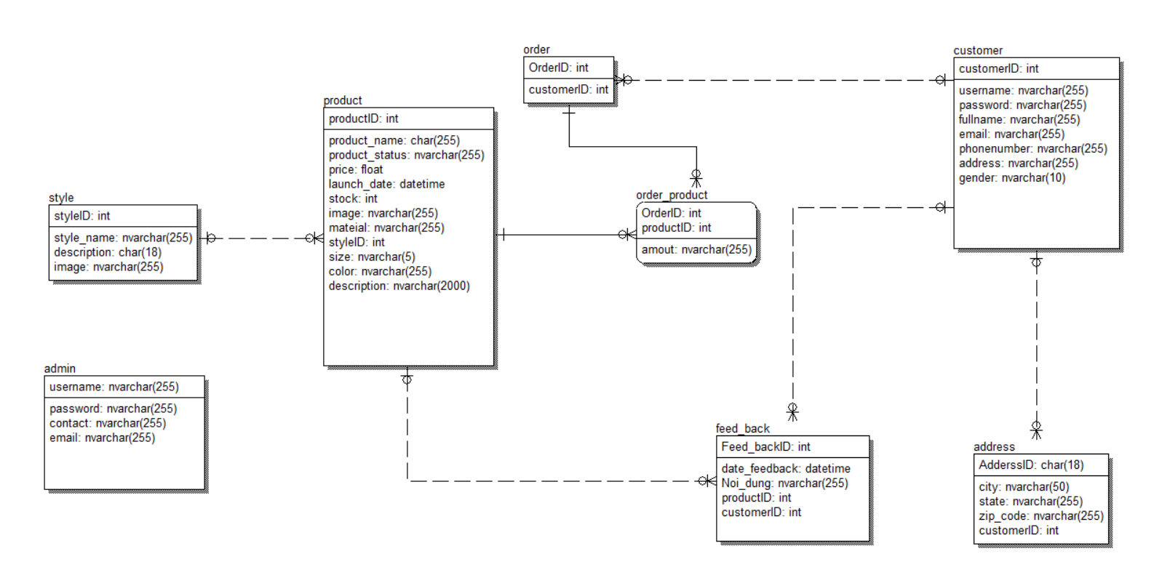
database diagram

Slide 8
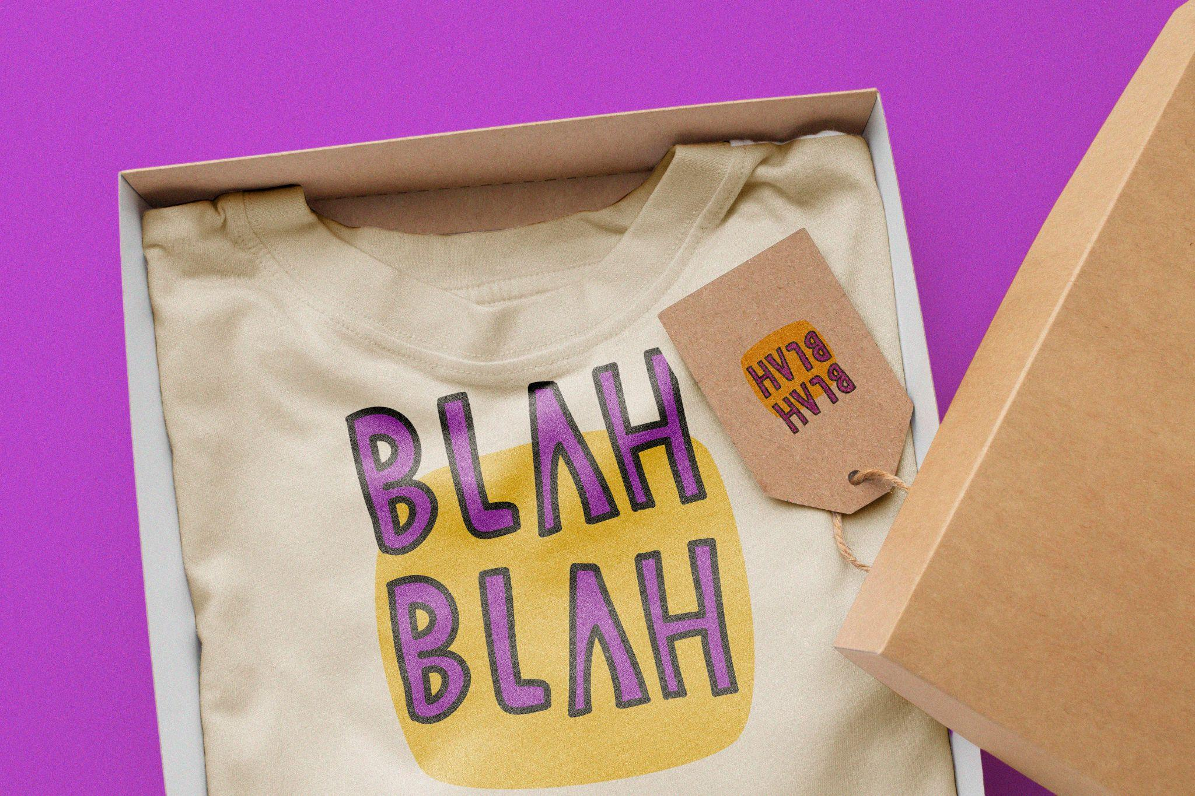
04 project functions

Slide 9
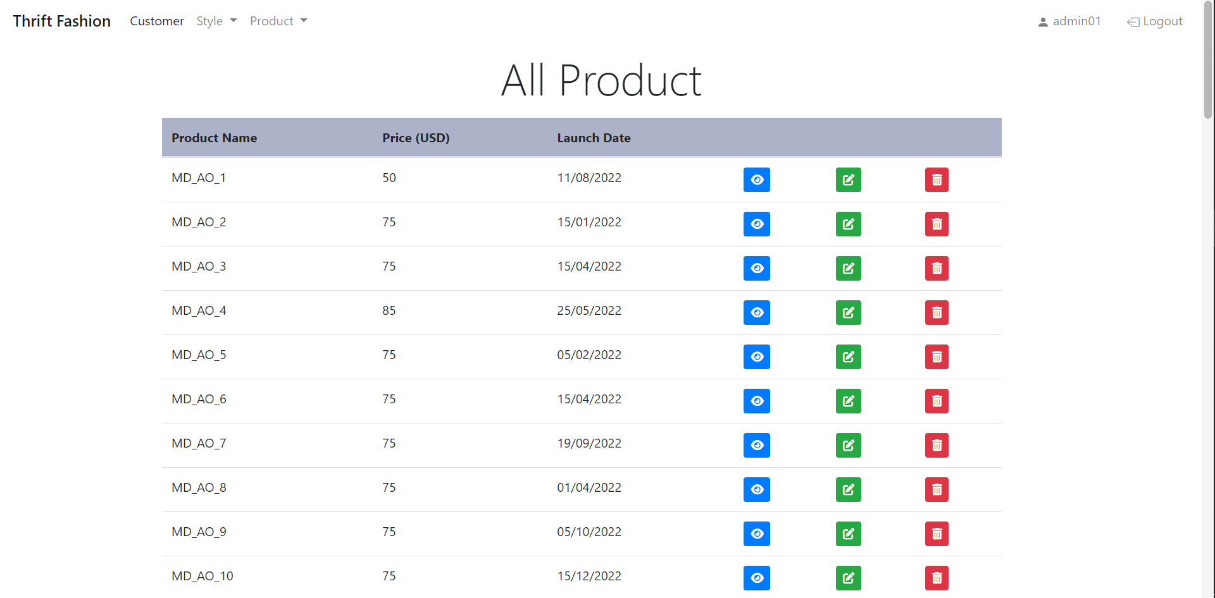
View product

Slide 10
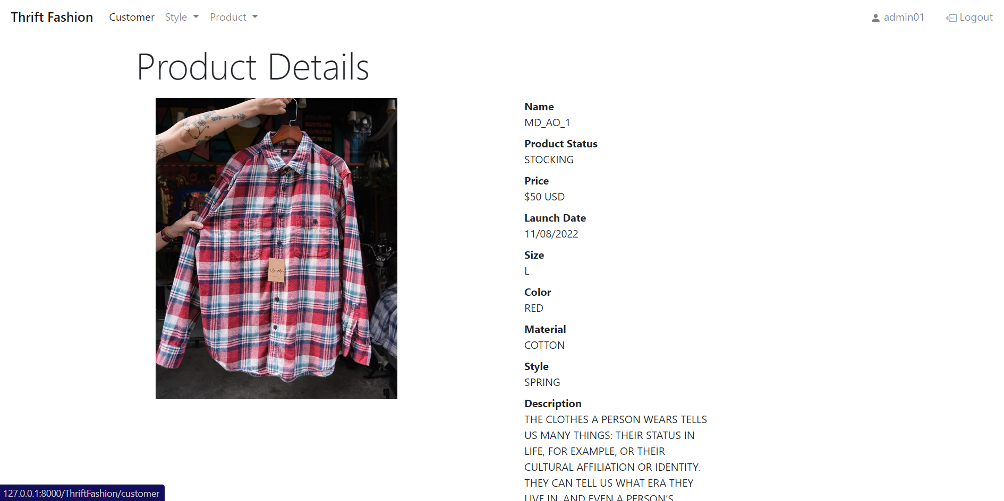
View product

Slide 11
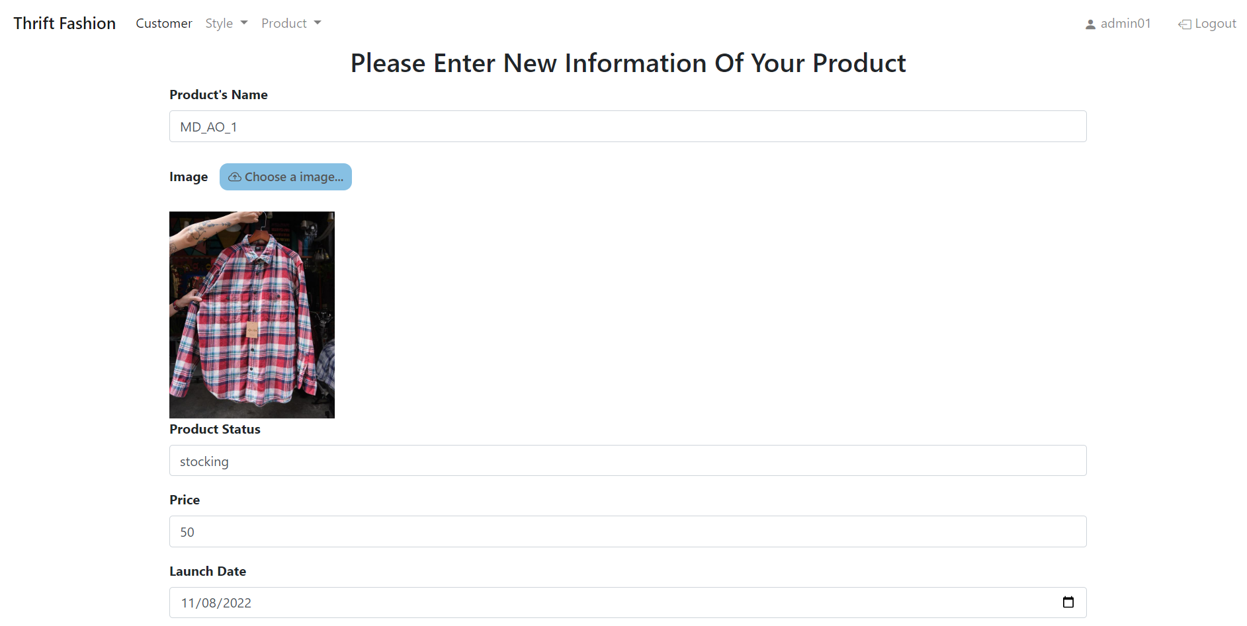
Update product

Slide 12
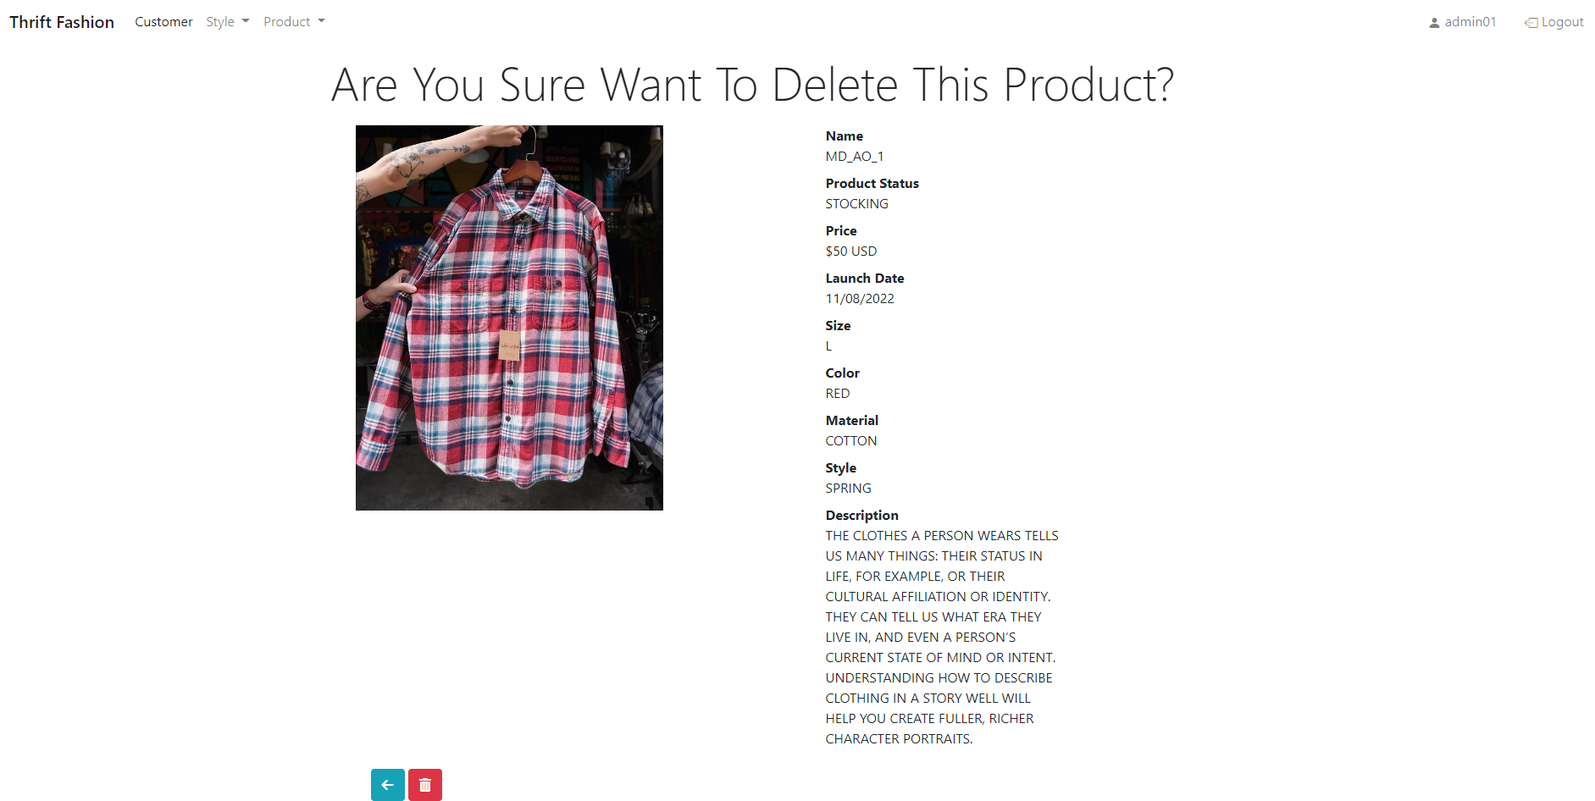
Delete product

Slide 13
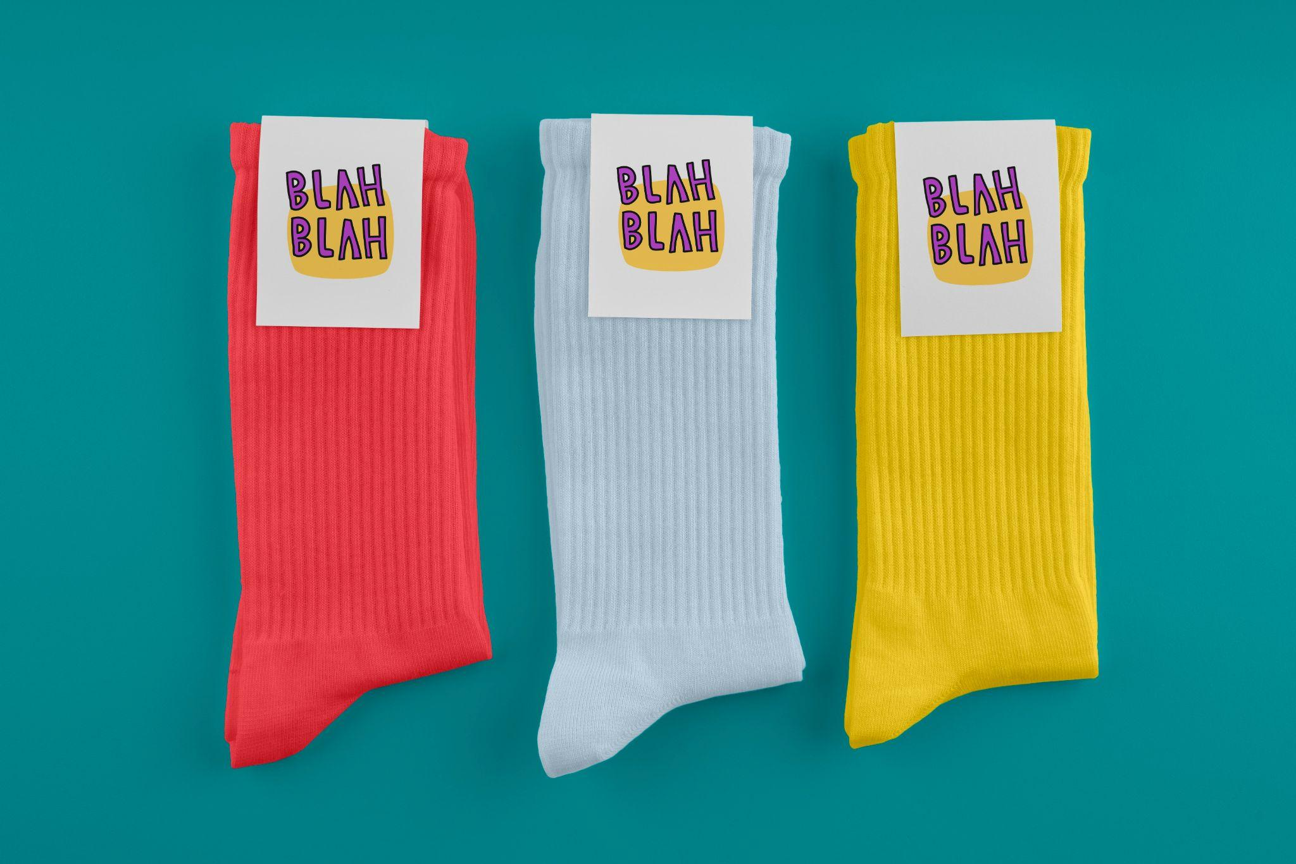
THANKS!
Do you have any questions?
youremail@freepik.com
+91 620 421 838
yourwebsite.com
Please keep this slide for attribution

